Slide 1
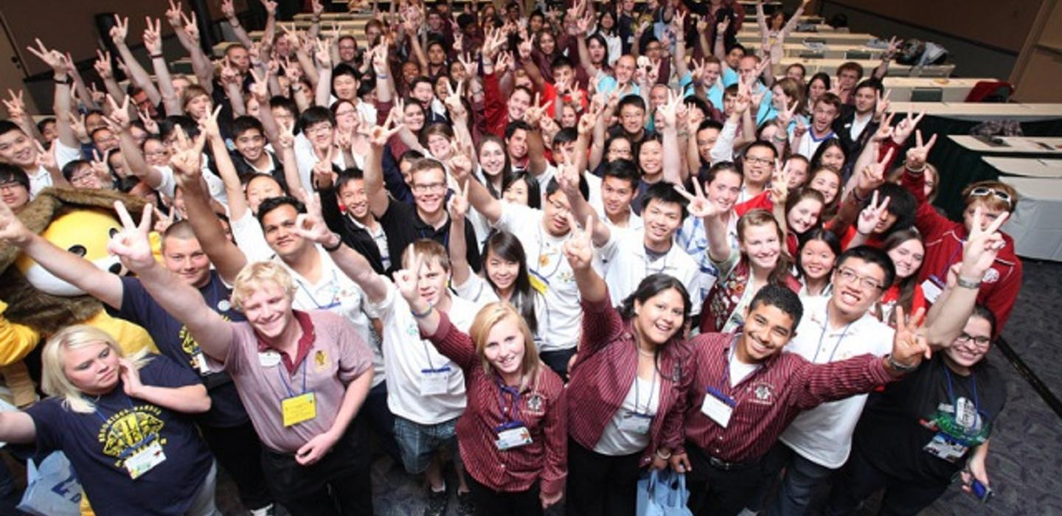
Invitation To Join The New
Silicon Valley Cyber Leos Club
Sponsored By
Silicon Valley Cyber Lions Club - MD4-C4 U.S.A
svcyberlions@gmail.com
Who are Lions and Lions Clubs International?
Founded in 1917, LCI is the world’s largest & best humanitarian volunteering non-profit organization globally.
It has 1.4+ million members in ~214 countries/territories with ~48,000 clubs.
Lions/Leos serve thousands of community projects, including: vision, environment, hunger, diabetes, childhood cancer.
Please visit: www.lionsclubs.org.
Who are Leos and Leos Clubs?
“Leo” stands for: L = Leadership, E = Experience, O = Opportunity,
Leos serve communities worldwide. They serve since 1957 when the first Leos club was formed in USA.
Leos Clubs are chartered, sponsored and supported by Lions Clubs.
Leos and Lions serve similar projects with kindness and support each other.
Please visit: https://www.lionsclubs.org/en/discover-our-clubs/about-leos
Background Needs:
Students needs service hours and opportunities to serve the communities – a requirement for higher education.
Only a small percentage of high schools globally has Leos Clubs available.
Leos will become more responsible, caring and giving individuals for the future societies.
Our Communities around the world needs humanitarian services and disastrous supports.
Why Join Silicon Valley Cyber Leos Club?
It is a new Cyber Leos Club Platform with LCI acknowledgment.
Allow students 12-18 years old to become Leos locally and globally, paid for by the S.V. Cyber Lions Club.
There will be no dues and existing Leos members can join as Associate Leo Members.
It includes junior high students to be Leos members beside HS students.
As a Charter Leo Member, this will bring social responsibility and credibility for your future resume/bio.
This Club can be both school base/community base depending on the membership distribution and their preference.
As a new Club, it is open to suggestions, experiment, and will grow into what is best to recruit members and to serve.
Its management structure will have directors for various programs, groups and territories.
Cyber, social media and other online communications are more attractive/effective to reach out and connect to Leos/Lions both locally and globally.
S.V. Cyber Lions Club has members worldwide and together with Leos, we will serve others in need locally & globally.
Additional Benefits & Specialty Educational Programs:
S.V. Cyber Leos will have opportunity to take free online classes customized and provided by our sponsoring corporate partners, donors and Lions.
Planning underway to offer animated videos to teach leading edge programs like: Cyber Security, Block Chain,
Members may also participate in the Youth Exchange Program hosted by Lions/Leos families in the U.S. & globally.
Plan to apply 501 c3 or Non-Profit status in the future to provide funds for scholarship, projects and for YEP.
The Next Steps:
Please complete the Application Form & Parental Consent form and return to svcyberlions@gmail.com.
Please indicate your interest, ideas and if you want to take on any leadership role, especially for International Leos.
Please discuss this opportunity within the family and also with school teachers.
Email us with any questions and inputs.
Watch These Fun Videos:
Xxxxxxxxx
ccccccccc

Slide 3
Background
Lion Clubs international was founded in 1917, over 101 years ago in Chicago by Melvin Jones.
LCI is recognized as the largest and best volunteer charitable organization in the world by Time Magazine and UN numerous times.
Lions Clubs can sponsor and help charter Alpha Leos Clubs (12-18) or Omega (18-30) to serve others locally and worldwide.
There are 1.4+ million Lion Members & 200,000+ Leos Members in 48,000 Clubs from 215 countries and territories.
Examples of our service programs besides community services: Vision, Hunger, Youth, Environment, Pediatric Cancer, Diabetes, Literacy, Disaster Relief, Veterans, Measles, Disabilities, community services, missions...., etc.

Slide 4
Why A Leos Club?
L = Leadership, E = Experience, O = Opportunity
Leo members will have opportunity to gain experience in leadership, teamwork, commitment, interpersonal relationship, civics duties, ...
Leos Club will provide you with a platform to connect with peers locally and globally with silimar interest and offer opportunities to serve & help others at your early stages in life and beyond.
Community services including performances will be counted as as community hours for college applications.
Being a Leo member will add credibility and recognition to your resume/Bio because of what you do…
LCI will provide insurance coverage for Lions & Leos events as well as matching grants and youth exchange program worldwide.
Program publicity and activities support from Lions via “myLion” app.

Slide 5
S.V. Cyber Leos Club Advantages #1
The S.V. Cyber Lions Club is the most culturally and nationally diversified Club with members around the world. This Cyber Leos Club will have similar structure and guidelines that will offer the Leos more opportunity to connect and serve globally.
This club will be both school base and community base. It can accepting students from any schools or any community. It is open to all students and clubs locally and globally. Please invite others to join you.
Members from a single school can meet at school or meet at other locations after school hours, similar to members from separate HS in the community. Members outside of the community or globally can meet online or via social media.
Parents or guardians are welcome to join you in your meetings and service activities and become a Lion members.

Slide 6
S.V. Cyber Leos Club Advantages #2
Based on the recommendation of your Executive Director, Ms. Sherln Chew, you or members of The Great Wall Youth Orchestra & Chorus are invited to become a member of the S.V. Cyber Leos Club. SVCLC will pickup the cost with Lions Clubs International.
Any students (12-18) from any schools around the world can also be a member.
Depending on your Officers' vote, you may have your internal meetings before your practice and/or to meet online via your preferred social media.
S.V. Cyber Leos Club will have in-person and online meeting with it's members and the frequency will be determined by the selected/apponted Club's BODs.
S.V. Cyber Lions Club will support your fundraising events and help with LCI matching grant application as well as getting liability insurance coverage.
S.V. Cyber Lions Club will introduce your program and service to Lions and Leos Clubs around the world via the new “myLion” app.

Slide 7
Advantages & Objectives (Summary)
12-18 year old members of The Great Wall Youth Orchastra & Chorus will be invited to join the Silicon Valley Cyber Leos Club as a Branch Club with their main focus in promoting orchestral music and vocal talents in youth and community services.
From this Club, Leos members will be connected with the Multiple District 4-C4 Leos District of several hundred members from over a dozen clubs locally and over 200,000 Leos around the world.
This connection will offer opportunities to share your interests with others and participate in youth exchange program and performance in other countries.
This will also open up community and international service projects to serve tbe less fortunate people and to better yourself as a young individual.
Your common interest is music and you can start your own future "Giving Through Music" Program to help serve others. Use “myLion” app – your own Facebook for Humanity! Download it now.

Slide 8
What's Next?
Please visit: lionsclubs.org to find out more about the Leos program.
Talk with your parent and family members to get their support.
Contact us and ask questions.
Invite others to join the Club.
Fill out the application/parent consent form.
Return to Ms. Sherlyn Chew or Mr. Victor Siu.
Think about being an officer of this Branch Club - president, 1VP, 2VP, Secretary, Treasurer. Some of these officers will also be invited to participate in the S.V. Cyber Leos Club operation.

Slide 9
Contact Information
Sherlyn Chew - 1sherlynchew@gmail.com
Victor Siu - vsiu@gmail.com
Lion Michael Chan - lionmichaelchan@gmail.com
Lion Benny Xiong - lionbennyxiong@gmail.com
Carmen Yeung - carmen318212@gmail.com
Lion Lam Tse - lamtse5354@gmail.com

Slide 10
For Your Interest To Be A Member of The Silicon Valley Cyber Leos Club
Thank You

Slide 11
Application Form

